Slide 1
Time Coders
Our digital will

Slide 2
Table of contents
01
02
Our Team
Stages
03
04
Used Technologies
The Application

Slide 3
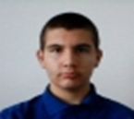
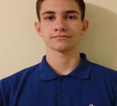
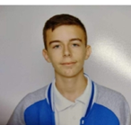

Our Team
Miroslav Ganev
Lazar Apostolov
Georgi Iavanov
Stelian Nikolov
Scrum Trainer
10A
Back-end developer
10B
Back-end developer
10V
Front-end developer
10G

Slide 4
OUR IDEA
Our idea was to create an application that would help make a will easier digitally, as our users would be able to bequeath any material benefits.

Slide 5











Stages
Finishing the app and making documentation
Making basic app’s design
Stage 1:
Stage 2:
Stage 3:
Stage 4:
Creating logo and discussing ideas about the app
Implementing our app idea through code

Slide 7
Let’s get to the app

